Slide 1
MSCS – 621 FALL 2018
Cloud Computing
Final Project PPT
WATSON ASSISTANT FOOD COACH APP
By
Prabhleen Kaur
MS Software Development
Prof. Jin Hwang

Slide 2
INTRODUCTION
The project is an application based on Watson assistant and the purpose of this project is to deploy the application into hybrid cloud environment and ,configure and run in two different cloud environment. This application demonstrates how the Watson assistant (formerly conversation) service can be adapted to use tone analyzer's tone along with intents and entities in a simple chat interface

Slide 3
WATSON API
WATSON ASSISTANT API -
Watson Assistant API is used as a chatbot for building a conversation interface into any application. Watson assistant knows when to search for an answer from a knowledge base, when to ask the user for clarity. It can be pre-trained with respect the the application by creating a skill and adding the Intent to it.
WATSON TONE ANALYSER API -
Watson tone analyser understand the emotions and communication style in what people write. It predicts whether they are happy, sad, confident, and more.

Slide 4
WHAT DOES THE APP DO
The application interface is designed for chatting with a coaching bot. Based on the time of day, it asks you if you've had a particular meal (breakfast, lunch, or dinner) and what you ate for that meal.
The chat interface is in the left panel of the ui, and the json response object returned by the assistant service in the right panel. Your input is run against a small set of sample data trained with the following intents:
Yes: acknowledgment that the specified meal was eaten
no: the specified meal was not eaten
help exit
The dialog is also trained on two types of entities:
Food items unhealthy food items these intents and entities help the bot understand variations your input.
After asking you what you ate (if a meal was consumed), the bot asks you how you feel about it. Depending on your emotional tone, the bot provides different feedback.

Slide 5

APP DEMO

Slide 6
TOOLS AND DEPENDENCIES USED
IBM CLOUD SERVICES
AWS CLOUD SERVICES
NODE.JS
IBM CLOUD CLI
DOCKER
DOCKER-COMPOSER
VIRTUAL BOX

Slide 7
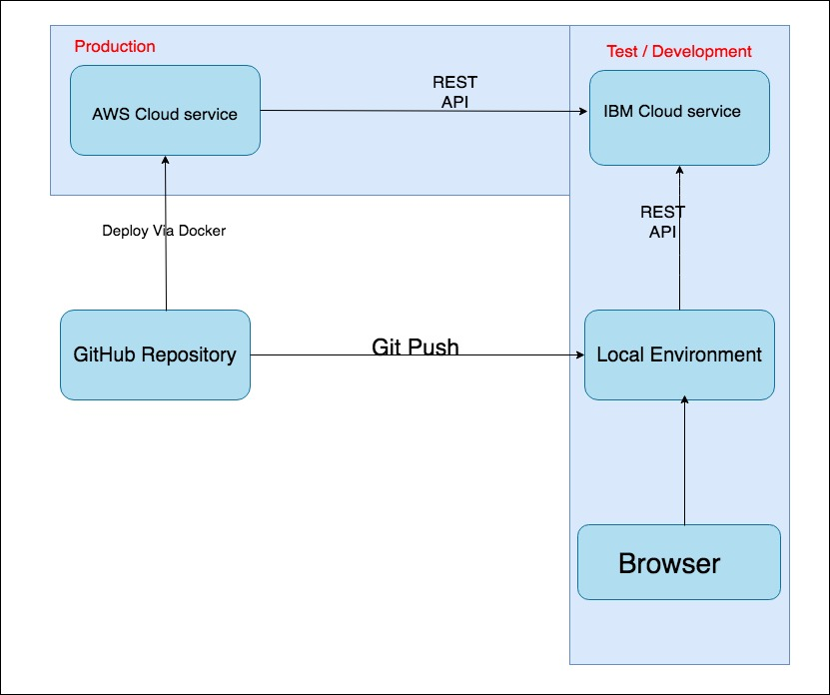
ARCHITECTURE OF THE APP
The Architecture of the project explains the development and the pilot environment.
The project is developed using IBM Cloud Services(Bluemix + Watson) and Rest APIs.The application is deployed in the Local Cloud and Local Browser.AWS cloud service is used for deployment of the application in the hybrid cloud environment .The Vagrant ,Docker and Virtual box is used for deploying the app locally.
The GitHub is used as the source code repository.
The code is borrowed from github project https://github.com/watson-developer-cloud/food-coach.

Slide 8
STEPS FOLLOWED TO DEVELOP THE APP
To make the App Hybrid two different cloud services are used namely IBM Cloud Services and AWS Cloud Services.
Login to your IBM account
Create the Instance of the Watson Assistant Service and get credentials
Copy apikey and url .
Create the Tone Analyzer and get credentials and copy apikey along with the url.

Slide 9
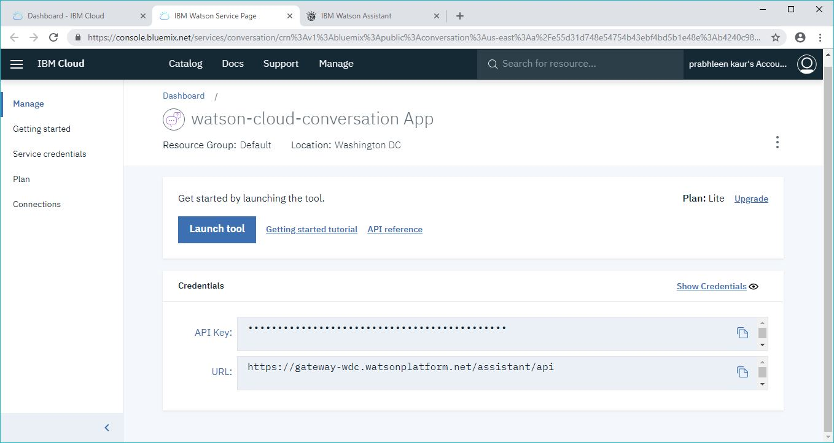
Apikey And Url

Slide 10
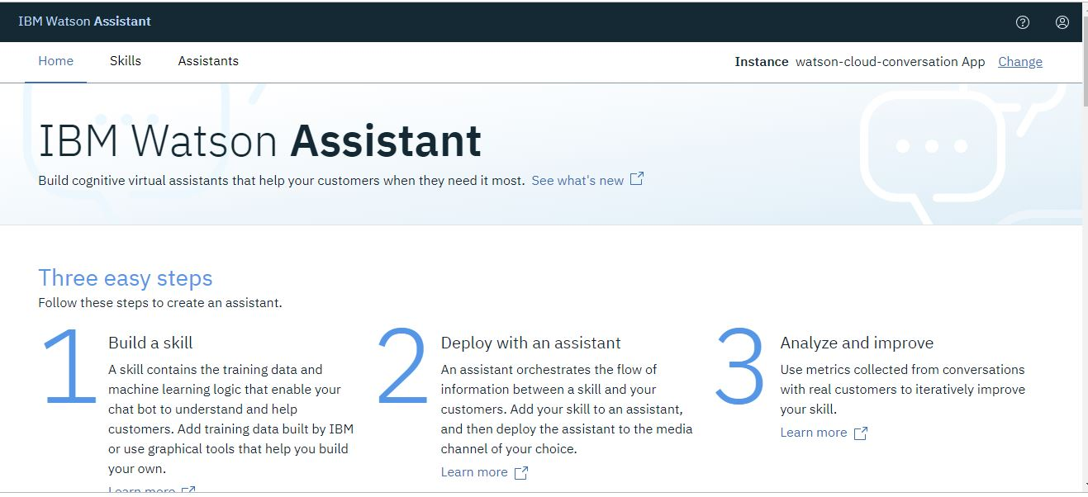
Open the Watson Assisstant Instance and create a skill by importing the json file into the workspace.The skill dashboard is created

Slide 11
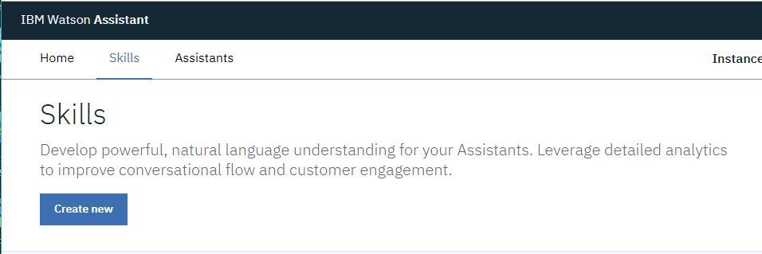
Create Skill

Slide 12
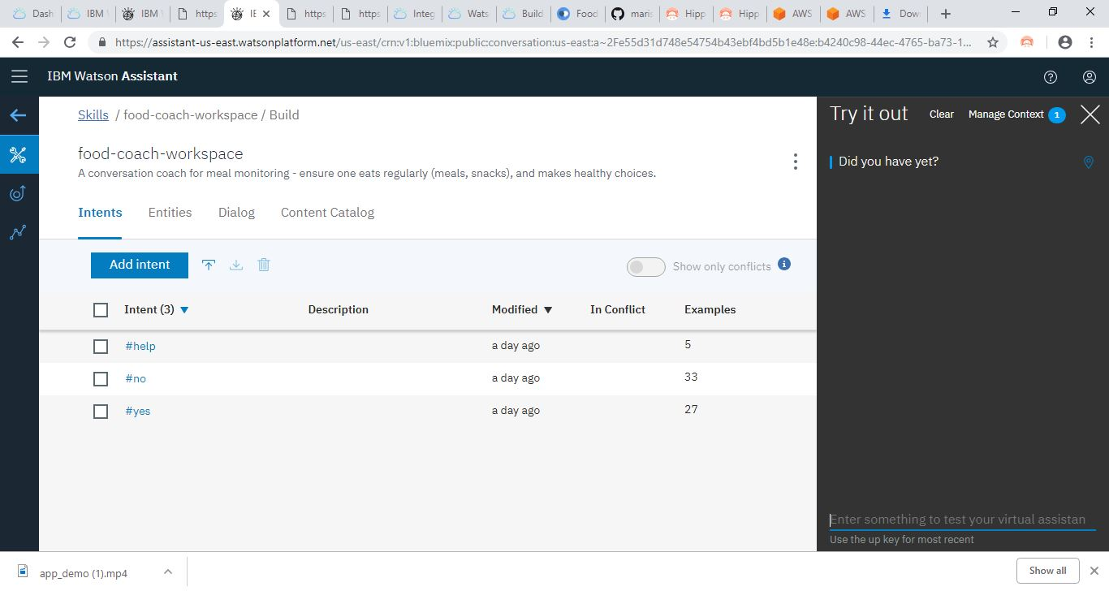
Food-coach-workspace

Slide 13
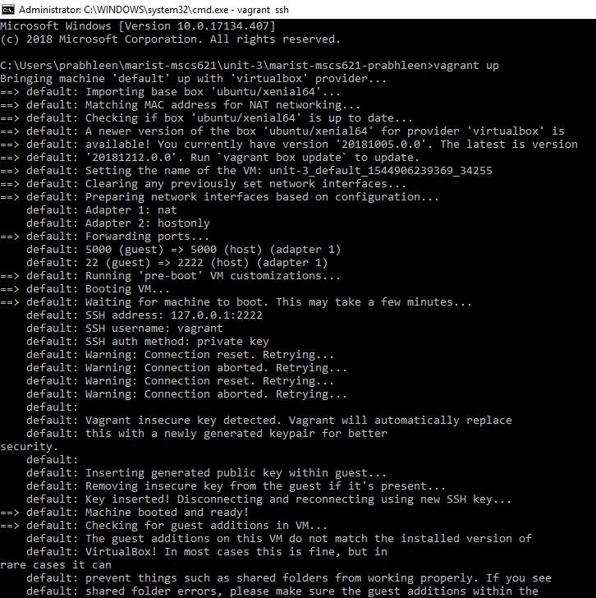
Deploy The Application Locally
In the Terminal ,Run vagrant Up
Run vagrant ssh

Slide 14
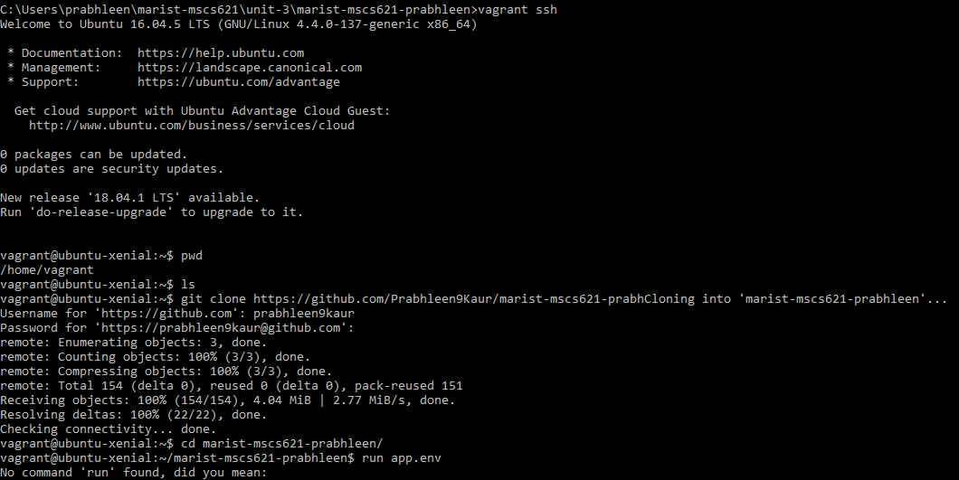

Slide 15
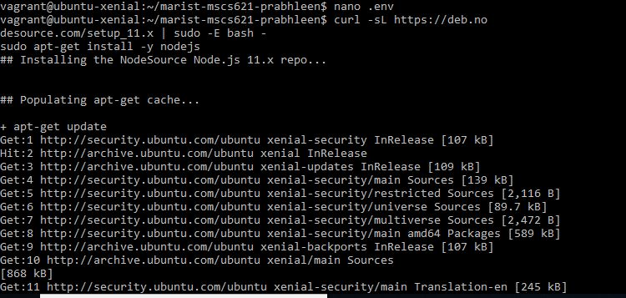
Clone the repository in the application folder
Edit the .env
Install the Dependencies :
Node.js

Slide 16
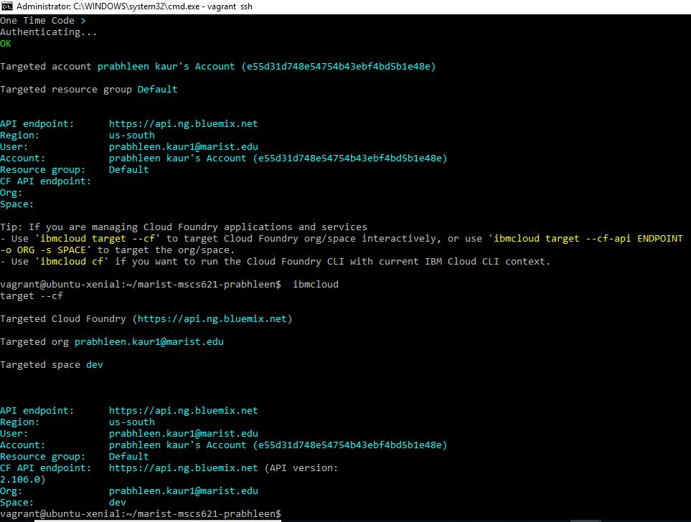
IBM Cloud CLI

Slide 17
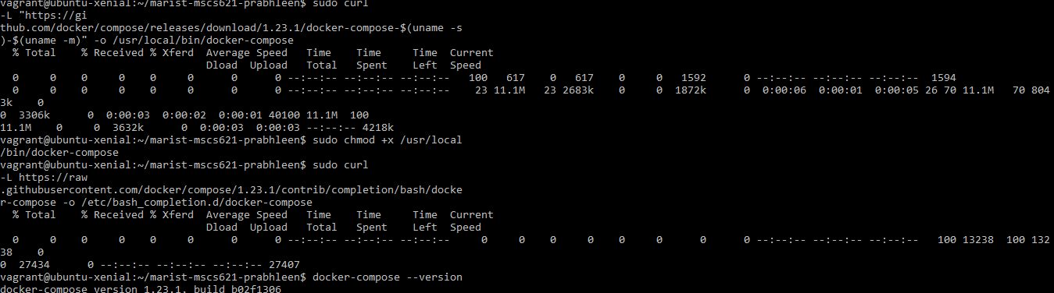
DOCKER

Slide 18
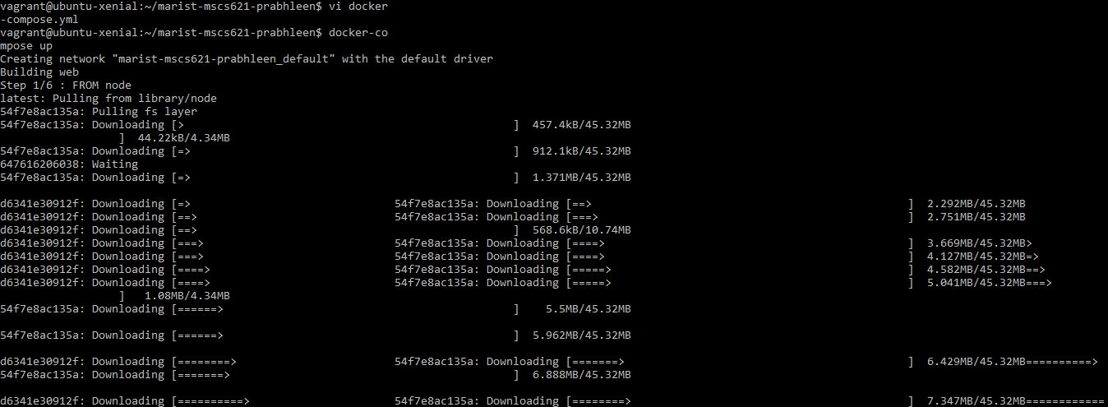
DOCKER-COMPOSE

Slide 19
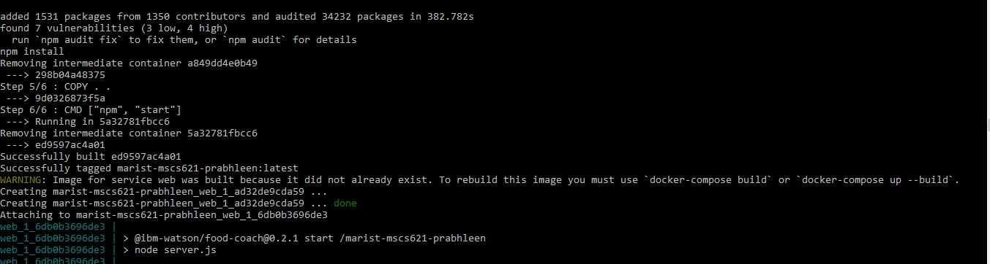
11. Run docker-compose up and view the Application in browser

Slide 20
Deploying The Application In The Aws Cloud
Login to AWS cloud with the AWS cloud console
Create an instance of AWS EC2 ubuntu
Create a new key pair with your name and download it to your local folder
Navigate to running instances on your EC2 dashboard
Copy the public DNS (ipv4) and ipv4 public IP
Under the menu in top left corner ,navigate to security groups
Select the newly created security group and select inbound below

Slide 21
Open up a terminal and navigate to folder with downloaded key file
Run
Chmod 400 <your key file> run
Ssh -i <key file> ubuntu@<public DNS (ipv4)> public DNS (ipv4) can be found in your AWS EC2 dashboard running instances
Clone the repo into the vagrant machine 'git clone https://github.Com/prabhleen9kaur/marist-mscs621-prabhleen.Git'
In the application folder, copy the .Env.Example file and create a file called .Env
Cp .Env.Example .Env
Open the .Env file and add the service credentials that you obtained in the previous step.
Add the workspace_id to the previous properties
Your .Env file should looks like:

Slide 22
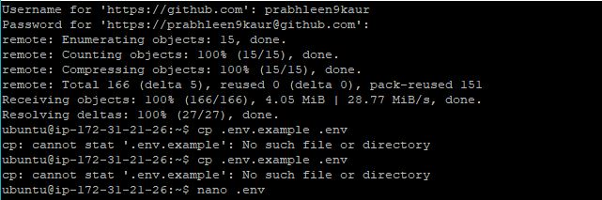

Slide 23
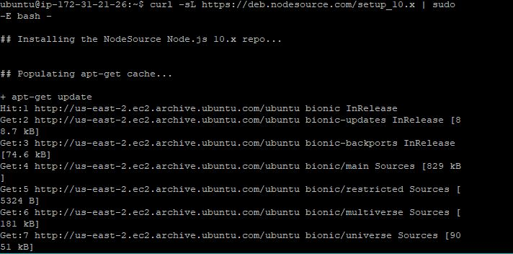
Install Node

Slide 24
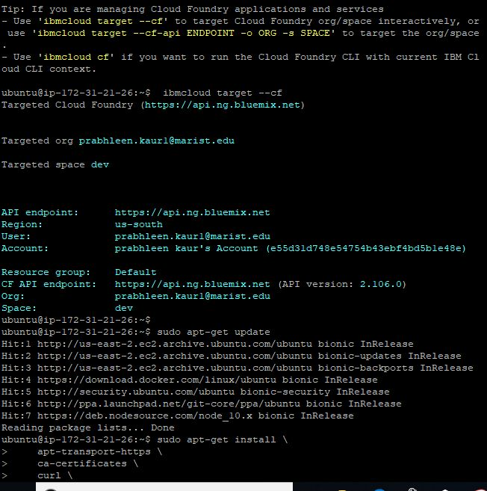
Install IBM Cloud CLl

Slide 25
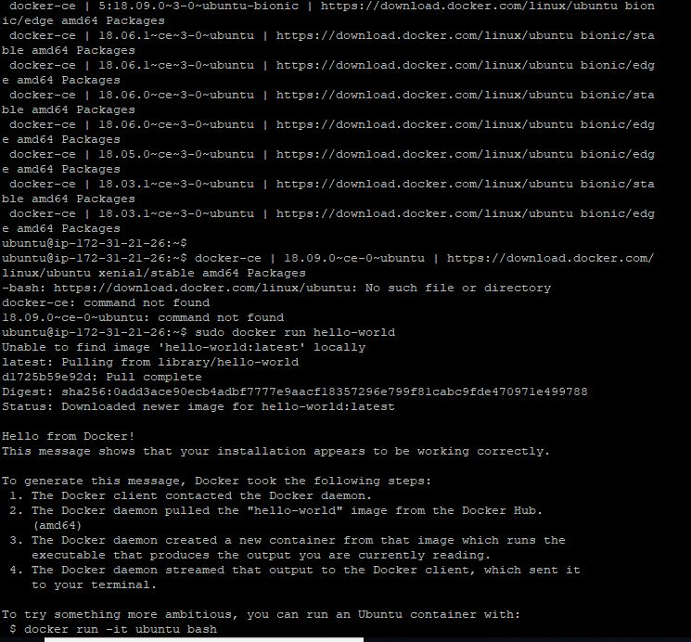
Install Docker

Slide 26
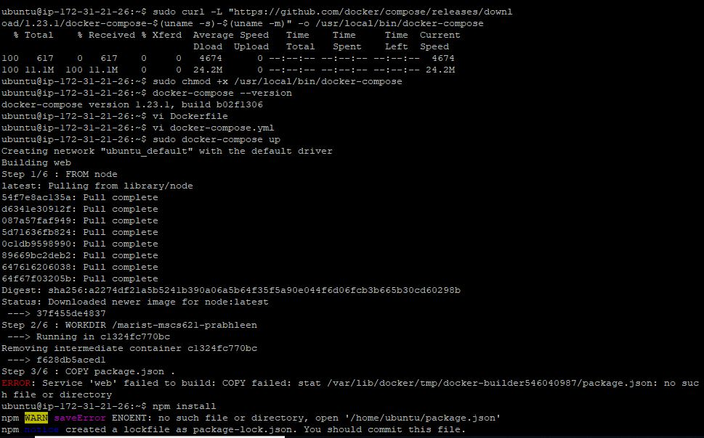
Install Docker-compose

Slide 27
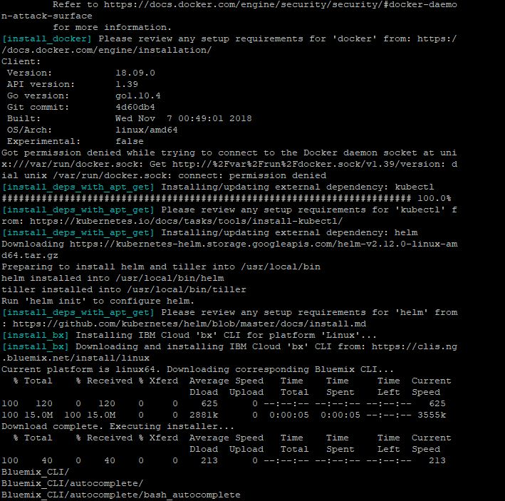
Run docker-compose up view the application in the browser

Slide 28
Difference In Original Github Project And This Project
This application is hybrid as it is deployed on two different hybrid cloud environment
  IBM Cloud services
  AWS Cloud services
The application is deployed in the local host using virtual box ,vagrant and docker
The application is containerized

Slide 29
TAKEAWAY FROM THE COURSE PROJECT
Ability to work and implement WATSON API and REST API using IBM Cloud services
Learned to create Instances in hybrid cloud environment
Use of docker through terminal
To containerize the app
To deploy an application locally and on cloud
Building a web application using Node.js

